Slide 1


OBJECT ORIENTED PROGRAMMING THROUGH JAVA

Slide 2

L5 - DATA TYPES

Slide 3


Slide 4
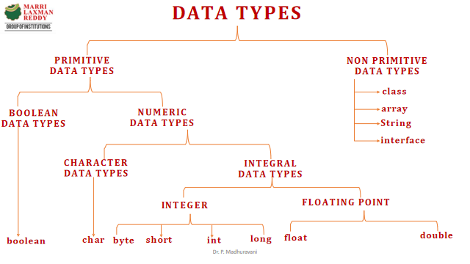

Slide 5
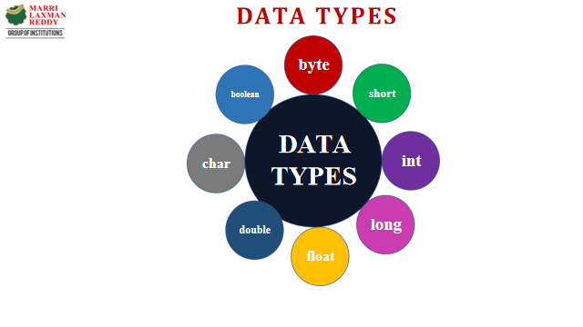

Slide 6
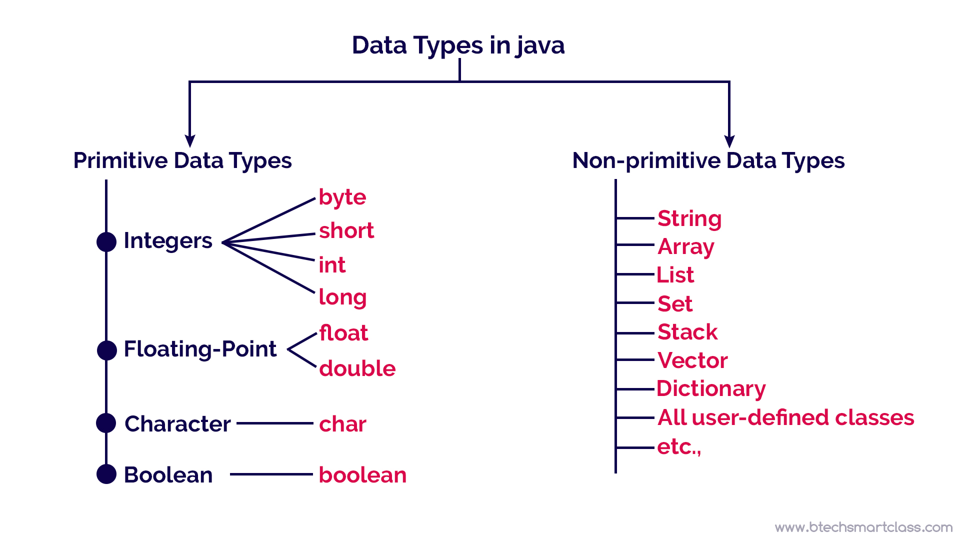
DATATYPES IN JAVA

Slide 7
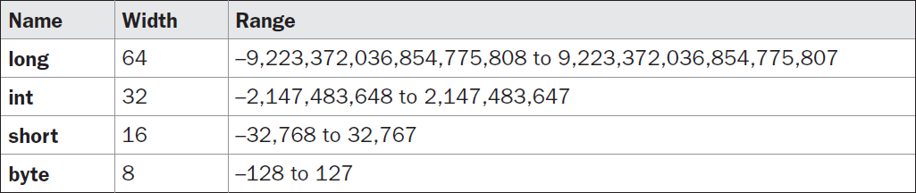
INTEGER:-
Java defines four integer types: byte, short, int, and long.
All of these are signed, positive and negative values.
Java does not support unsigned, positive-only integers.

Slide 8
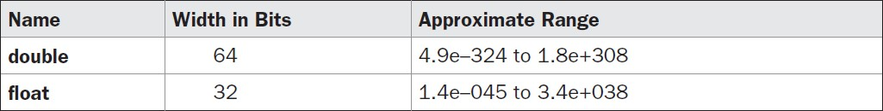
FLOAT DATA TYPE:-
Floating-point numbers, also known as real numbers, are used when evaluating expressions that require fractional precision.

Slide 9
CHARACTER DATATYPES:-
In Java, the data type used to store characters is char.
char in Java is not the same as char in C or C++. In C/C++, char is 8 bits wide.
Instead, Java uses Unicode to represent characters. Unicode defines a fully international character set that can represent all of the characters found in all human languages. It is a unification of dozens of character sets, such as Latin, Greek, Arabic, Cyrillic, Hebrew, Katakana, Hangul, and many more.
Thus, in Java char is a 16-bit type. The range of a char is 0 to 65,536. There are no negative chars. The standard set of characters known as ASCII still ranges from 0 to 127 as always
ASCII | UNICODE
American Standard Code for Information Interchange | Universal Character Set
Support 128 characters | Supports wide range of characters
Uses 7 bits to represent a character | Uses 8 bits or 16 bits to represent a character
Requires less space | Requires more space

Slide 10
BOOLEAN DATATYPES:-
Java has a primitive type, called boolean, for logical values. It can have only one of two possible values, true or false.
This is the type returned by all relational operators, as in the case of a <b
boolean is also the type required by the conditional expressions that govern the control statements such as if and for.

Slide 11
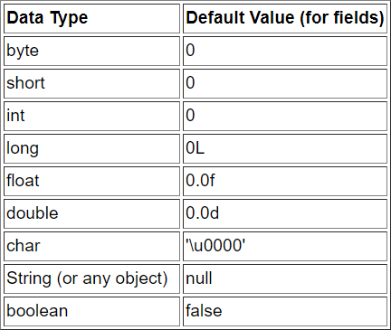
DEFAULT VALUES:-

Slide 12
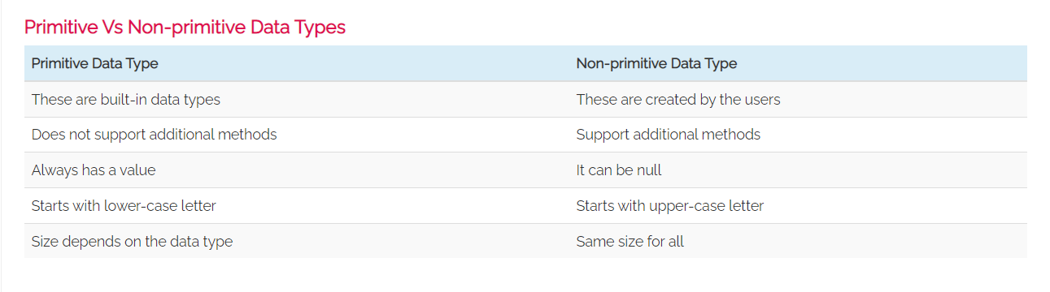

Slide 13
Next….
VARIABLES
Notes:
In Slide Show mode, click the arrow to enter the PowerPoint Getting Started Center.

Slide 14



